Slide 1
Indiana University
SharePoint Users’ Group
https://iuspug.iu.edu
Users’ Group Committee Leaders Andy Hill
Brian Hughes
Richard LeBeau
Cory P. Retherford – Founder
Richard Shepherd
November 15th, 2011

Slide 2
Todays Agenda
Its our last meeting of the year!
September IUSPUG
IT Statewide Conference Presentation
SharePoint My Sites
Forums Updates - https://iuspug.iu.edu/Lists/General%20Discussion/AllItems.aspx
Should we add Lists?
SharePoint Lists

Slide 3
How SharePoint Has Made Access To My Digital Information At IU More Convenient
Presenters Cory P. Retherford Richard LeBeau
September 29th, 2011

Slide 4
Todays Agenda
Overview of SharePoint My Sites
The IU SharePoint Cloud
Office Web Apps
Office client integration
Centralized data storage
Integration with existing services
Additional information
RESOURCES
Indiana University Users’ Group - https://iuspug.iu.edu

Slide 5
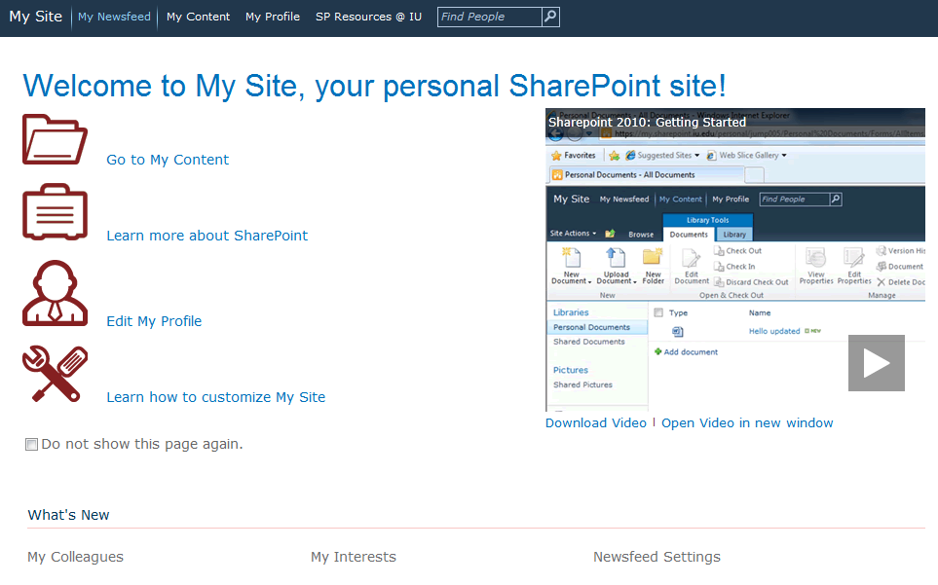
My Sites Overview
My Sites – https://my.sharepoint.iu.edu
20 GB quota
Access from anywhere
Offline access with SharePoint Workspace
Fully-featured personal SharePoint site collection
RESOURCES What is a My Site - http://kb.iu.edu/data/bahv.html
Microsoft Workspace 2010 - http://go.iu.edu/3Nk

Slide 6
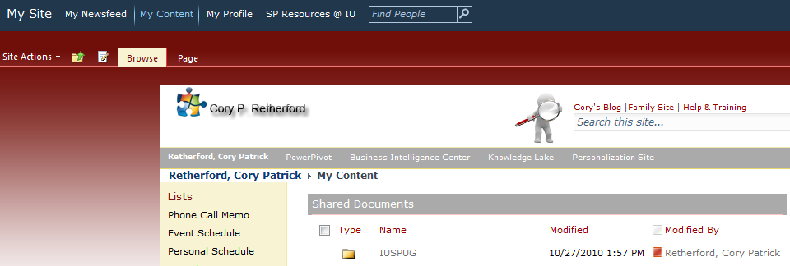
My Sites Overview

Slide 7
The IU SharePoint Cloud
Office Web Apps
Office client integration
Centralized data storage
Service integration
Exchange, Lync, Active Directory, and more
Access documents from anywhere, anytime, even off-line with SharePoint workspace
RESOURCES Microsoft Office Web Apps - http://go.iu.edu/3Nl

Slide 8
Office Web Apps
Create and edit Word, Excel, PowerPoint, & OneNote documents right in the browser
Excel, PowerPoint, & OneNote apps sync changes in real time

Slide 9
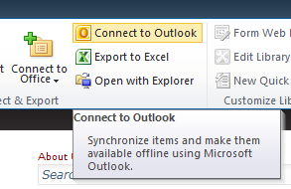
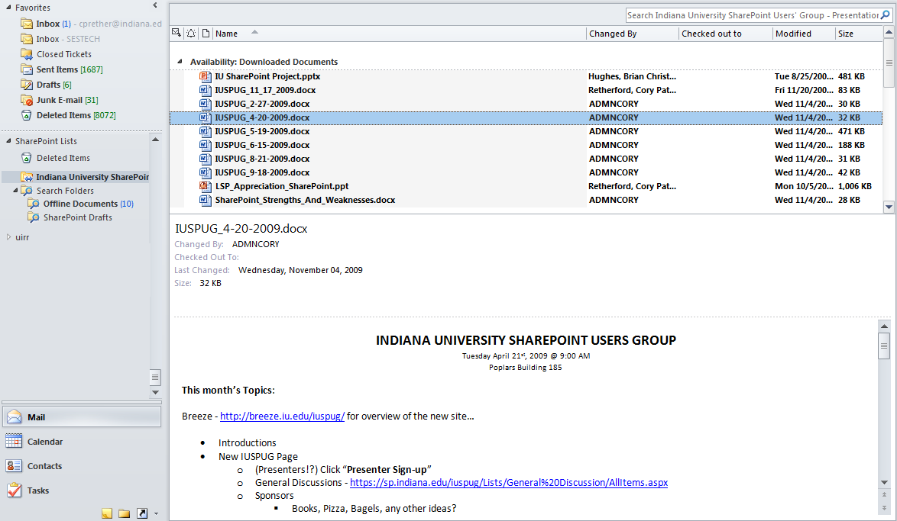
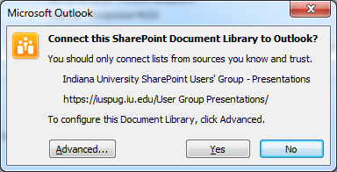
Office Client Integration
Outlook
Document library accessed via desktop client

Slide 10
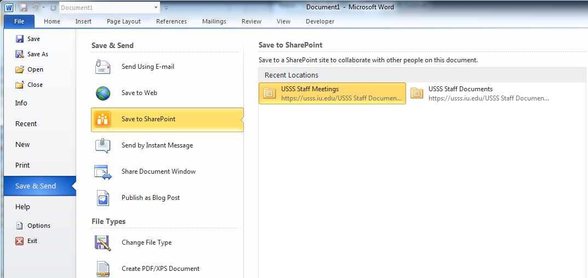
Office Client Integration
Word, Excel, & PowerPoint
Use Save and Send to publish directly to SharePoint
RESOURCES Microsoft Office Save and Send - http://go.iu.edu/3No

Slide 11
My Sites Drive Mapping
Mapping a Drive
On Campus
\\my.sharepoint.iu.edu@SSL\DavWWWRoot\personal\username
Off Campus or Mac
https://my.sharepoint.iu.edu/personal/username
RESOURCES http://kb.iu.edu/data/baih.html

Slide 12
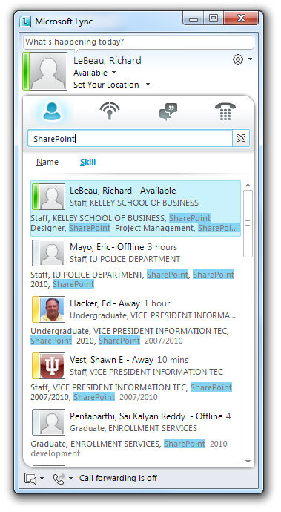
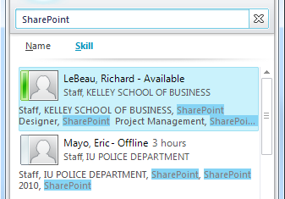
Service Integration
Lync
My Site profile information searchable in Lync desktop client

Slide 13
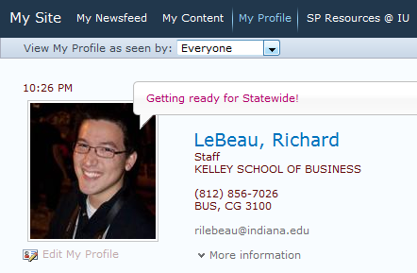
Service Integration
Active Directory
My Site profile picture syncs to Exchange and Lync
RESOURCES https://kb.iu.edu/data/bavm.html

Slide 14
Centralized Data Storage
SharePoint data is centrally stored, maintained, protected, and backed up in the IUB Data Center
Data owners still have access to manage and secure data
Full disaster recovery

Slide 15
Additional Information
UITS SharePoint Assistant
Available on IUware:
This assistant configures your Windows computer to integrate with the UITS centralized SharePoint environment and eliminates repeated prompts for username and passphrase. Handy!
http://iuware.iu.edu/Windows#Details/1486
Manual browser configuration instructions
Explorer - http://kb.iu.edu/data/baif.html
Firefox - http://kb.iu.edu/data/bahf.html
Mobile – Use https://myexternal.sharepoint.iu.edu
For the best SharePoint experience, use Windows 7, Office 2010, and Internet Explorer 8 or 9
RESOURCES Microsoft Office Save and Send - http://kb.iu.edu/data/bbbf.html

Slide 16
Indiana University
SharePoint Users’ Group
https://iuspug.iu.edu
Presentation SharePoint 2010 Lists
Cory P. Retherford
November 15th, 2011

Slide 17
SharePoint Training
SharePoint Lists
Non IU Attendees?
IU IT Training Classes
SharePoint 2010: Beyond the Basics
SharePoint 2010: The Basics
LSP Services EdCert Program, IT Training & Education, Microsoft…

Slide 18
SharePoint Lists
What Is A SharePoint List?
Lists
A Collection Of Information That You Share Using SharePoint
Lists Can Be Data Libraries
Lists Can Be BI
Lists Can Be Announcements, Contacts, Events, Tasks, Calendars, Etc…

Slide 19
SharePoint Lists
Overview Of USSS Technology Inventory Solution
Building No-code Applications From Lists
This Is A Sandbox Solution
That Means That It Was Built Entirely In SharePoint With No Code And No External Connections To Databases To Query Data Lists
Input Data Form
Various Views, Rules, Etc…
https://usss.iu.edu

Slide 20
SharePoint Lists
Where Are The Lists Located So That You Can View/Edit/Create A List
Site Actions (Need To Be A Site Admin)
Site Administration > Site Libraries And Lists
Anyone With Access To The Site Can Create A List With Options As Well
Alternatively Anyone With Read Rights Can View All Site Content > Lists

Slide 21
SharePoint Lists
Create New Content (Custom List)
Inventory
Overview List Settings
Create Columns
Columns Settings
Lookups (List)
Limits to how many you can have
Choice
Yes/No
Single Line Of Text
Date And Time
Person Or Group
Views
Forms, Etc…
https://usss.iu.edu/sites/ts/ListsPresentation

Slide 22
SharePoint Lists
Export Data
Export to Excel
Importing Excel Data
Create > More Options
Import Spreadsheet
Browse to document
Datasheet View
https://usss.iu.edu/sites/ts

Slide 23
SharePoint Lists
What Is SharePoint Designer?
Specialized Html Editor And Web Design Authoring Tool For Creating Or Modifying Microsoft SharePoint Sites And Web Pages And More…
Where To Get Microsoft SharePoint Designer 2010
IUWare.iu.edu Or Www.Microsoft.com
Open And Overview SharePoint Designer 2010
Various Functions
Used This Tool To Build And Author The Following Sites
https://Usss.Iu.Edu
https://Iuspug.Iu.Edu
http://Www.Retherfords.Com/Blogs/Coryretherford
http://Www.Retherfords.Com/Blogs/Coryretherford/Scuba
And Many More…

Slide 24
SharePoint Lists
BCS Connections Using SharePoint Designer
Open SharePoint Designer
Select Your Site (Collection)
External Content Types > Creation
In-uits-chedd1.ads.iu.edu
Site Action > More Options > External List
Authentication Mode In Designer
You Can Then Update The DB In Datasheet View Or Using A Form…
http://Www.Retherfords.Com/Blogs/Coryretherford/Lists/BCS Forums/
https://usss.iu.edu/Sites/Ts/Lists/DEV CHE DB BCS/

Slide 25
Advanced SharePoint Lists
Use of Microsoft Visual Studio 2010
Future topic for those who can stomach it!
Advanced Code Solutions (Sandboxed)
Andy Hill

Slide 26
Questions and Project Proposals
Project Proposals (Do you have an idea for a new IUSPUG project?)
Do you have existing business needs or functionality that we could collaborate on and be shared as a solution?
Let us know by using the Contact Us on the https://iuspug.iu.edu website at the bottom!

Slide 27
SharePoint Presentations
Calling all Presenters
Anyone want to present to the SPUG!?

Slide 28
Future Topics of Discussion
PowerPivot for SharePoint
Excel PowerPivot Lesson
SharePoint Designer 2010 Overview
Authoring Tools
Microsoft SharePoint Designer 2010
Microsoft SharePoint Designer Dashboard
SQL Server Report Builder
SharePoint 2010 Business Intelligence
Microsoft PerformancePoint and PowerPivot Services

Slide 29
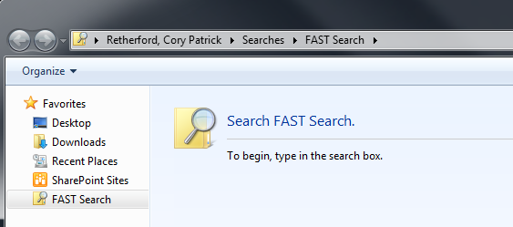
Future Topics of Discussion
StoragePoint (RBS)
Personal Dashboards
Search (SharePoint)
Windows OS
Academic Solutions Built on SharePoint
Ticket System
Asset Inventory
InfoPath
Web Parts creation
AD groups/users lookup

Slide 30
Thank you for your attendance.
The Indiana University SharePoint Users Group goals are to provide you with the tools and resources to engage, connect, and collaborate with the Indiana University SharePoint community. We hope to facilitate communication and discussion about SharePoint and Microsoft products.
Monthly Meetings – In person, Video conferencing, Breeze, and phone
https://iuspug.iu.edu

Slide 31
Thank you for your attendance and we hope this was an informative session.
You can visit the Indiana University SharePoint Users’ Group website to access additional resources, and engage, connect, and collaborate with the Indiana University SharePoint community. Monthly meetings are usually held on the 3rd Tuesday of every month both in-person and via Adobe Connect.
For more information visit the IUSPUG site and be sure to Contact Us!
https://iuspug.iu.edu

